Slide 1

STM32 Workshop
By Moktar SELLAMI

Slide 2
Plan
1
5
2
6
3
7
4
8
Why you should be here ?
STM32
Intro to embedded systems
Let’s do something
Microcontroller
STM32 GPIO
Motherboard VS Microcontroller
Writing the Software: HAL

Slide 3
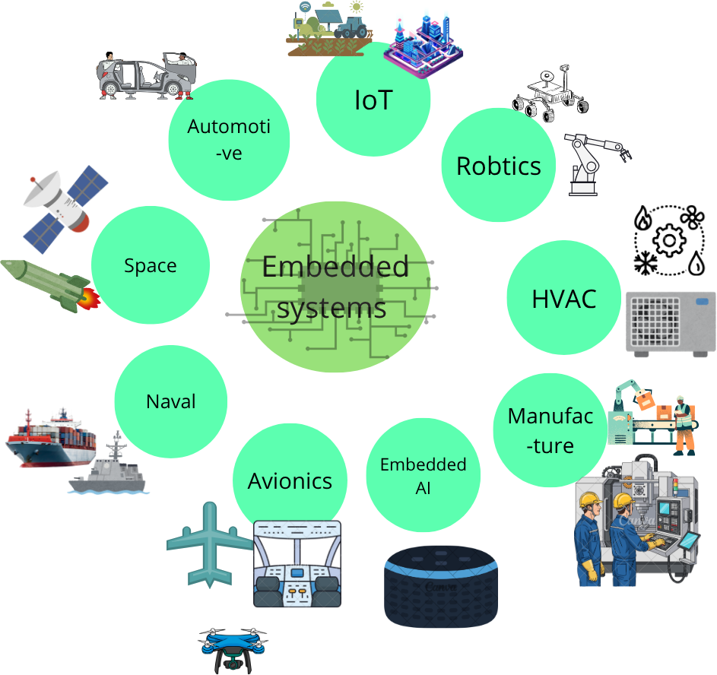
Why you should be here ?
The field Embedded systems:

Slide 4
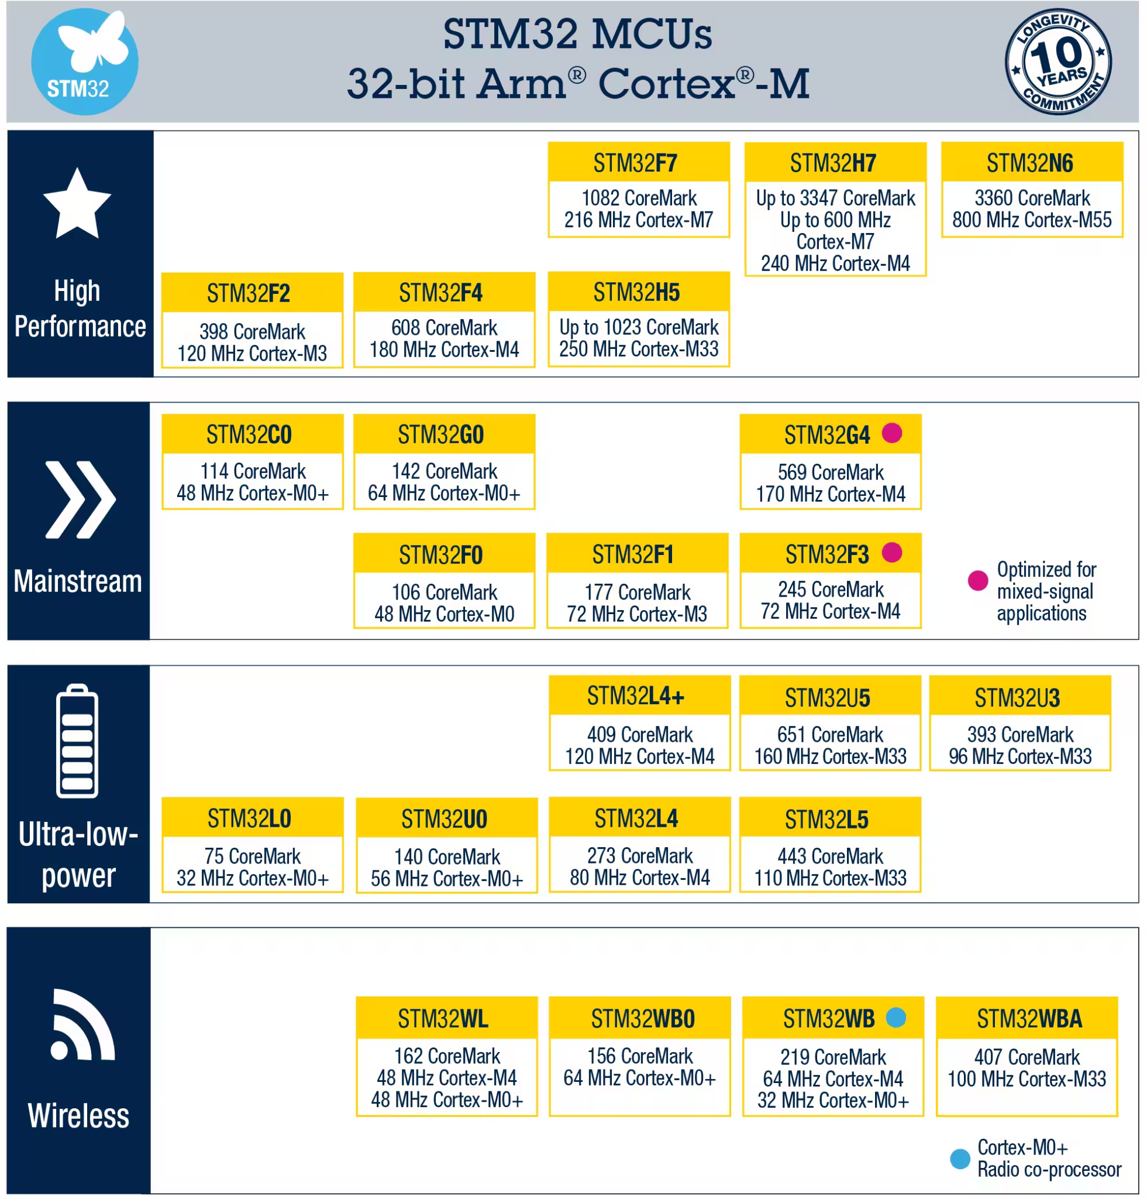
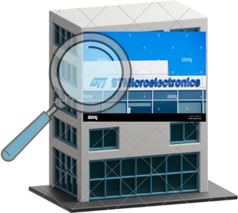

Why you should be here ?
Why STM32: (For MCU)
1. Unmatched Scalability & Portfolio
(+ 1500 MCU variants)
2. Powerful & Comprehensive Ecosystem
3. Leadership in Performance & Power Efficiency
Why STM32: (For Students)
1. A way to get an internship
2. A bridge from Arduino
3. Provides an ecosystem for newbies (CubeMX)
4. Community

Slide 5
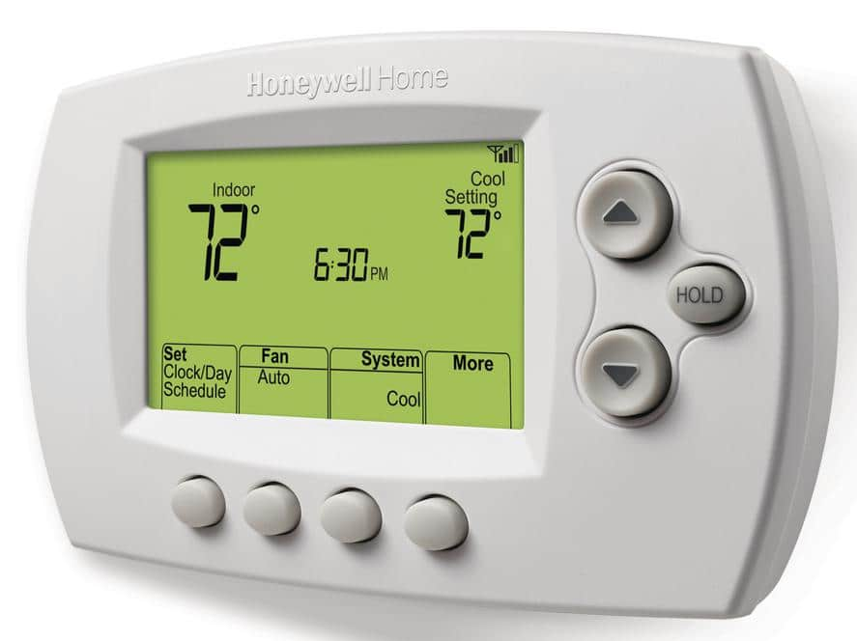
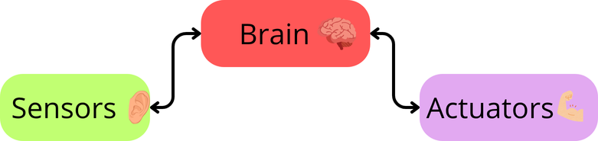
Introduction to embedded systems
Embedded systems are specialized computing systems designed to perform specific functions within larger systems.
Thermostat

Slide 6
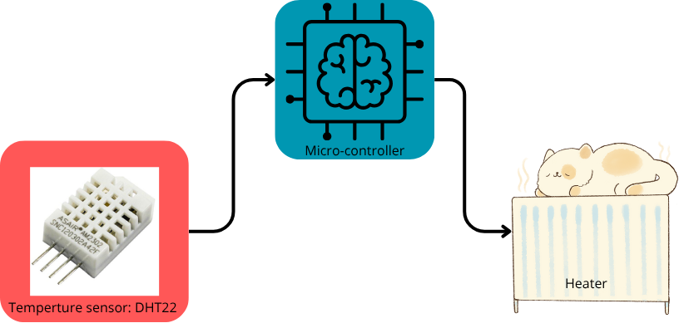
Introduction to embedded systems
THE BRAIN :

Slide 7
Microcontroller
A microcontroller is a compact integrated circuit that integrates many components.
It is categorized with its limit resources:
Low processing power : 12 Mhz to 700 Mhz
Low memory capacity: 2KB to 1MB
Low storage capacity: 4KB to 20MB
Energy consumption: 10 mW to 2W

Slide 8
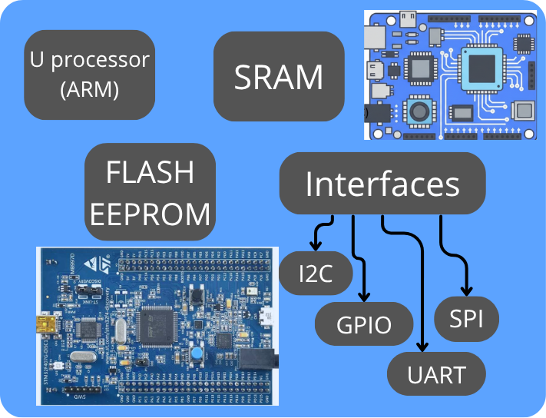
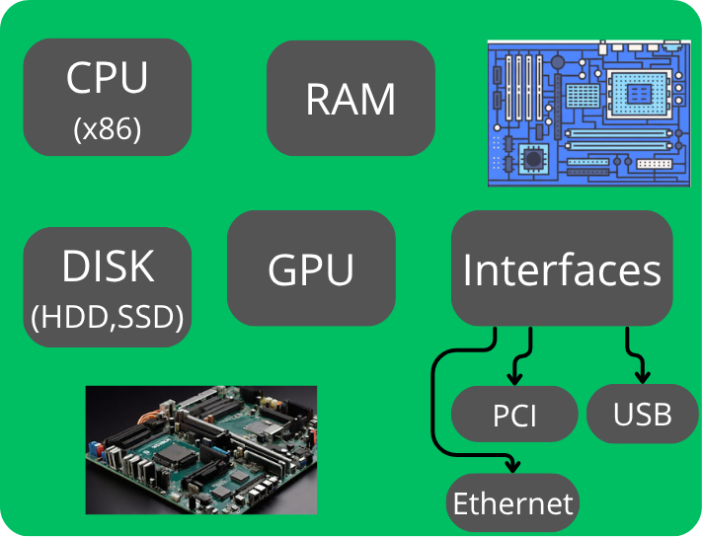
Analogy between motherboard and Microcontroller
Microcontroller
Motherboard

Slide 9
STM32
What is STM32?
Family of 32-bit microcontrollers by STMicroelectronics
Use ARM Cortex-M cores (M0, M0+, M3, M4, M7, M33)
Launched in 2007 with F1 series
STMicroelectronics
Largest semiconductor company in Europe
Founded in 1987 (France + Italy merger)
Headquarters: Geneva, Switzerland
49,602 employees, $13.27B revenue (2024)
Families
Mainstream: C0/G0/G4/F0/F1/F3
High Performance: H7/H5/F7/F4/F2
Low Power: L0/L4/L5/U0/U3/U5
Wireless: WL/WB0/WB/WA
AI: N6
Applications & Fields
Industrial automation (PLCs, robots, HMIs)
Consumer electronics (smart devices, wearables)
Internet of Things (IoT)
Medical equipment
Automotive systems

Slide 10
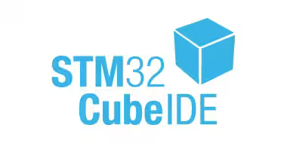
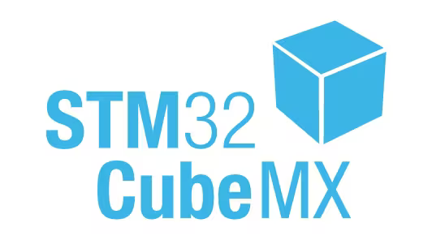
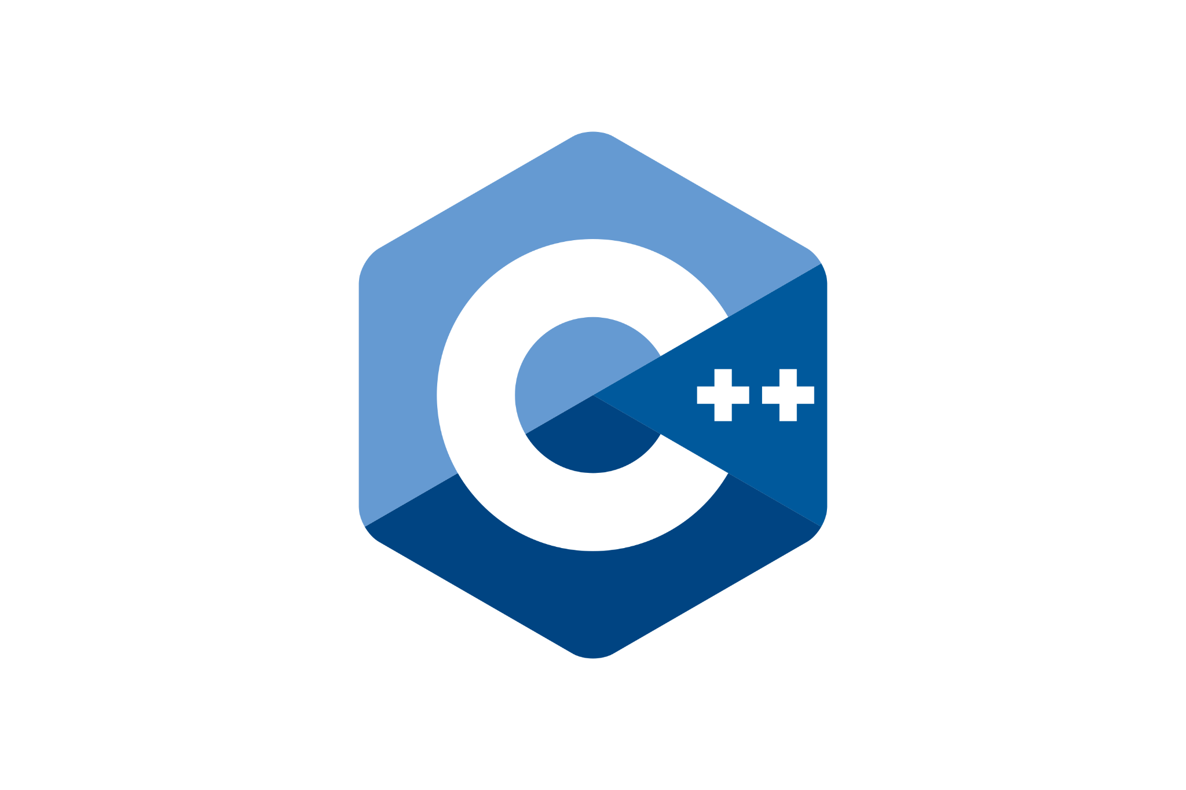



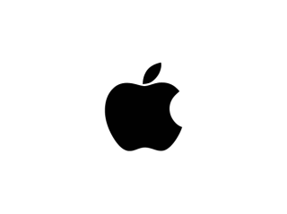

STM32 Ecosystem:

Slide 11
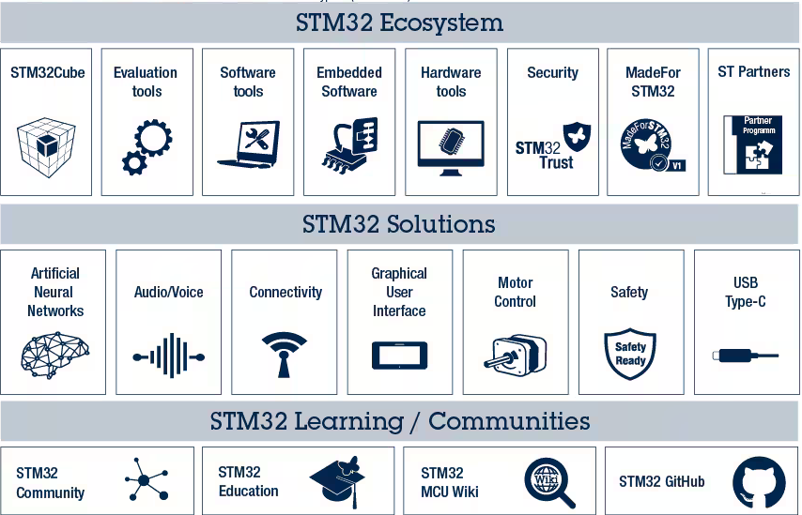

Slide 12
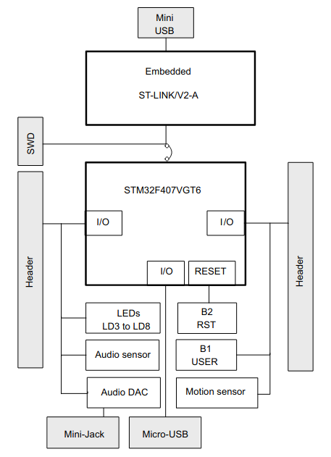
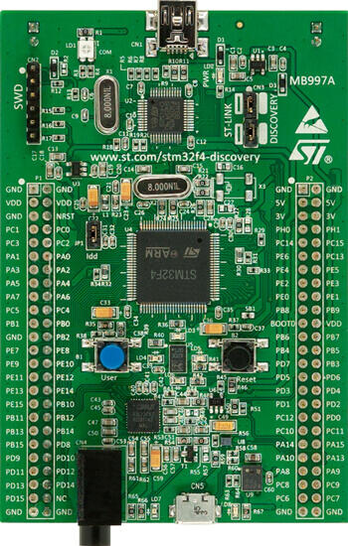
Overview: STM32F407-DISCO1

Slide 13
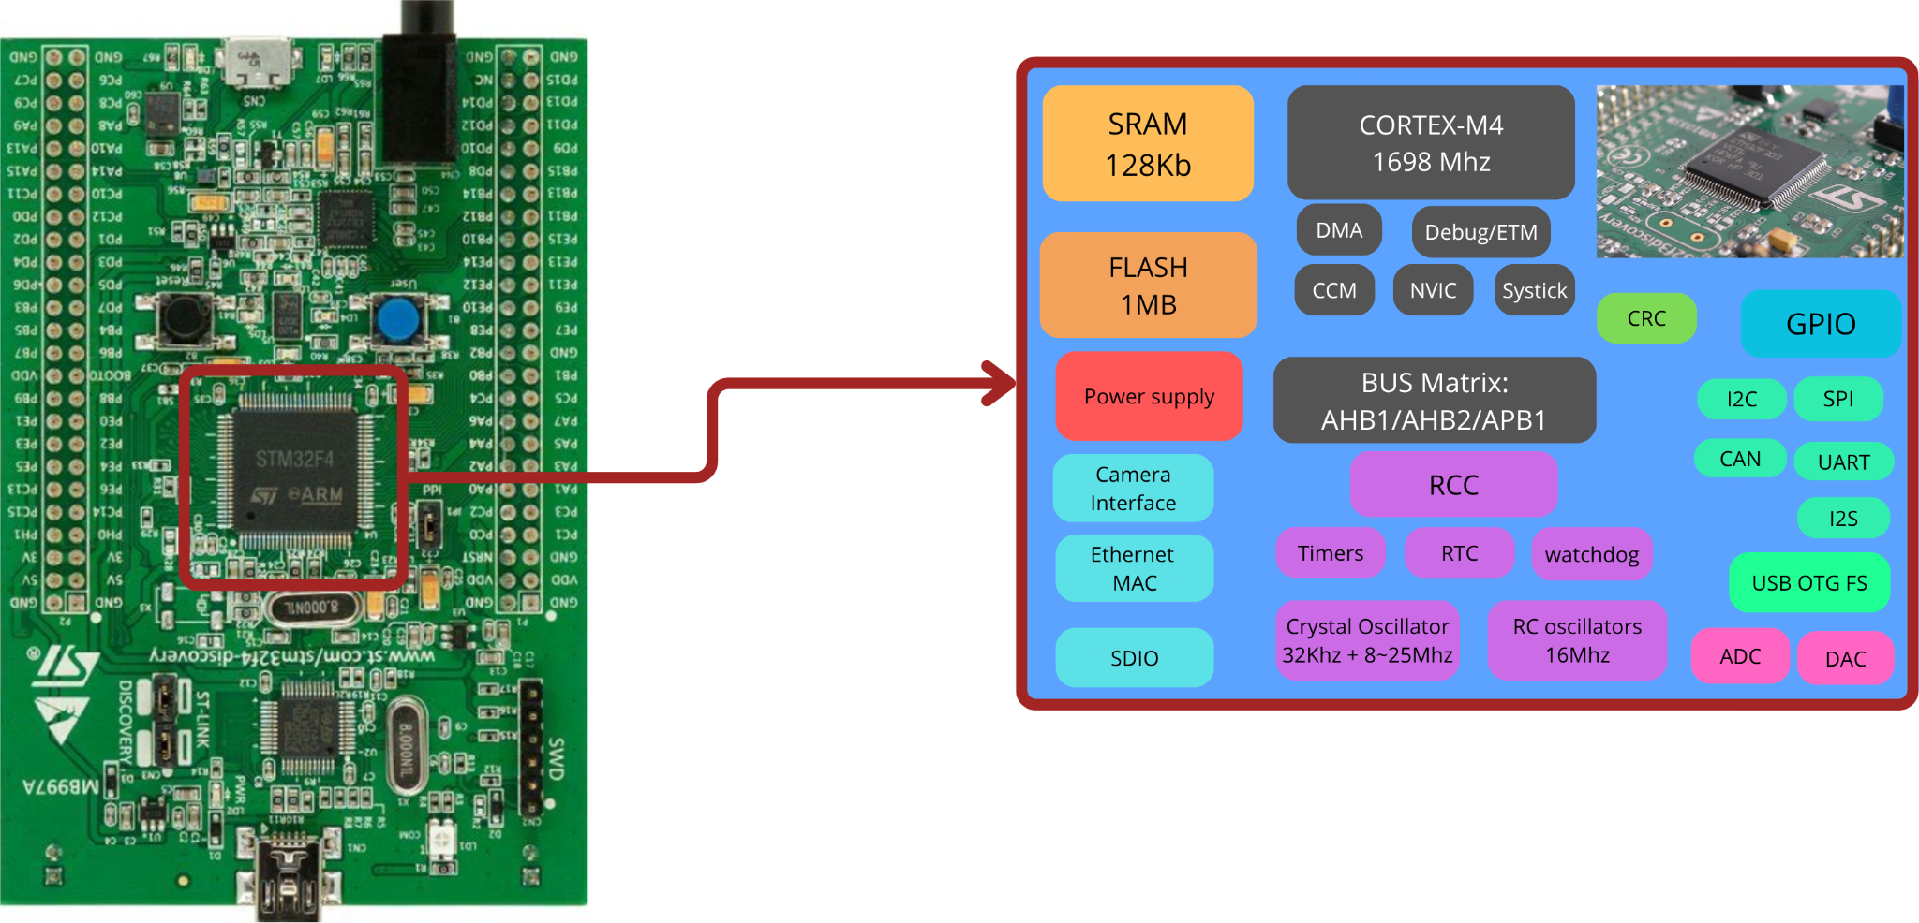
Overview: STM32F407 Microcontroller

Slide 14
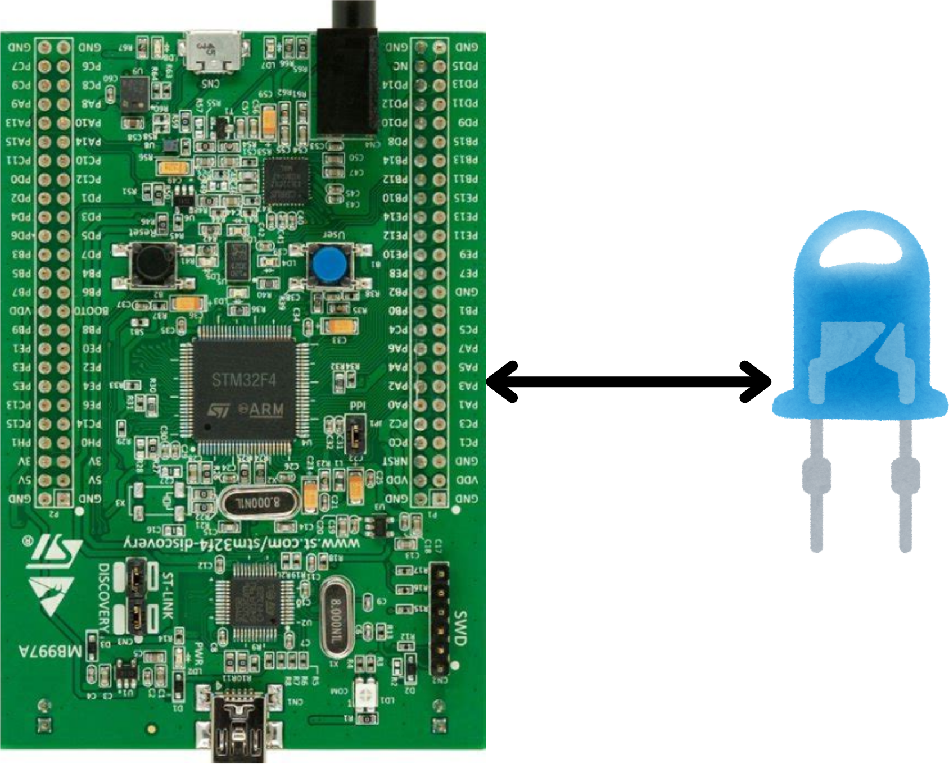
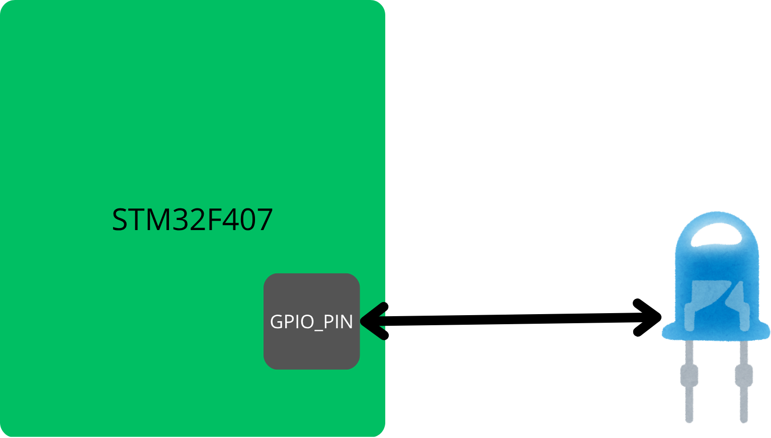
Let’s Do something :
Case Study: Toggling an LED

Slide 15
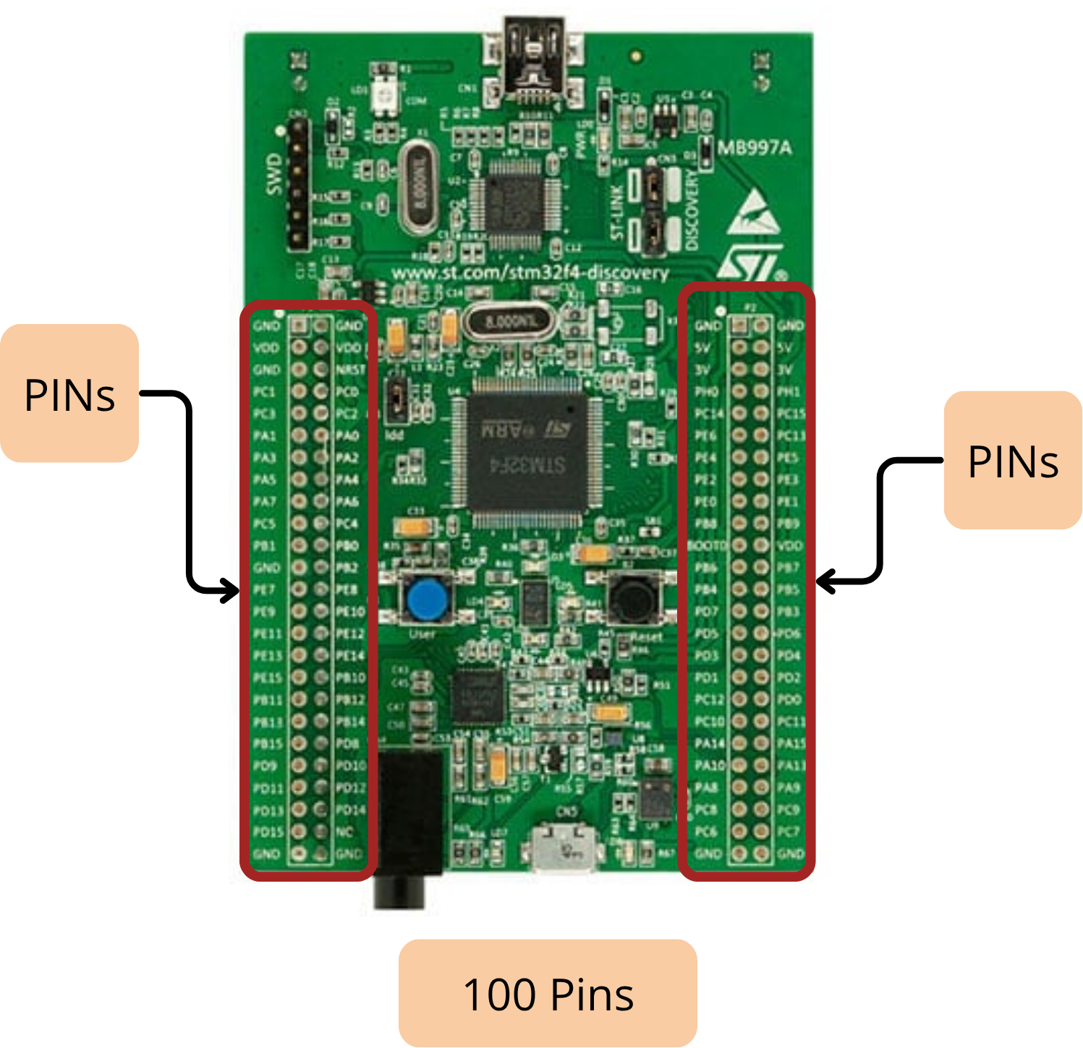
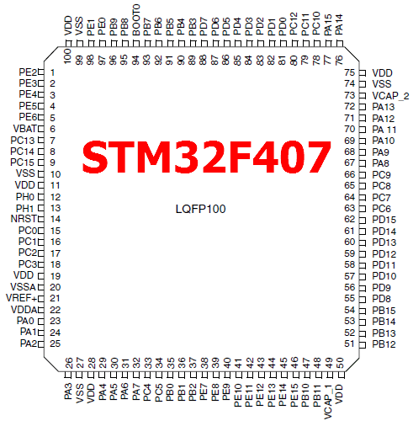
STM32 GPIO : General purpose Input Output

Slide 16
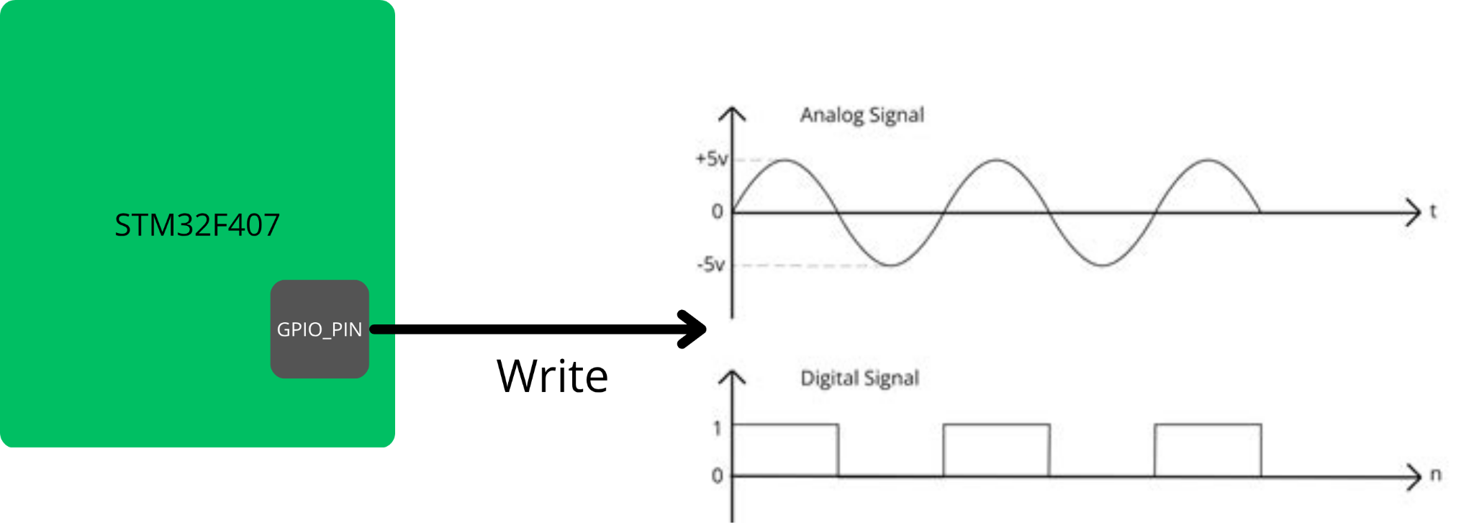
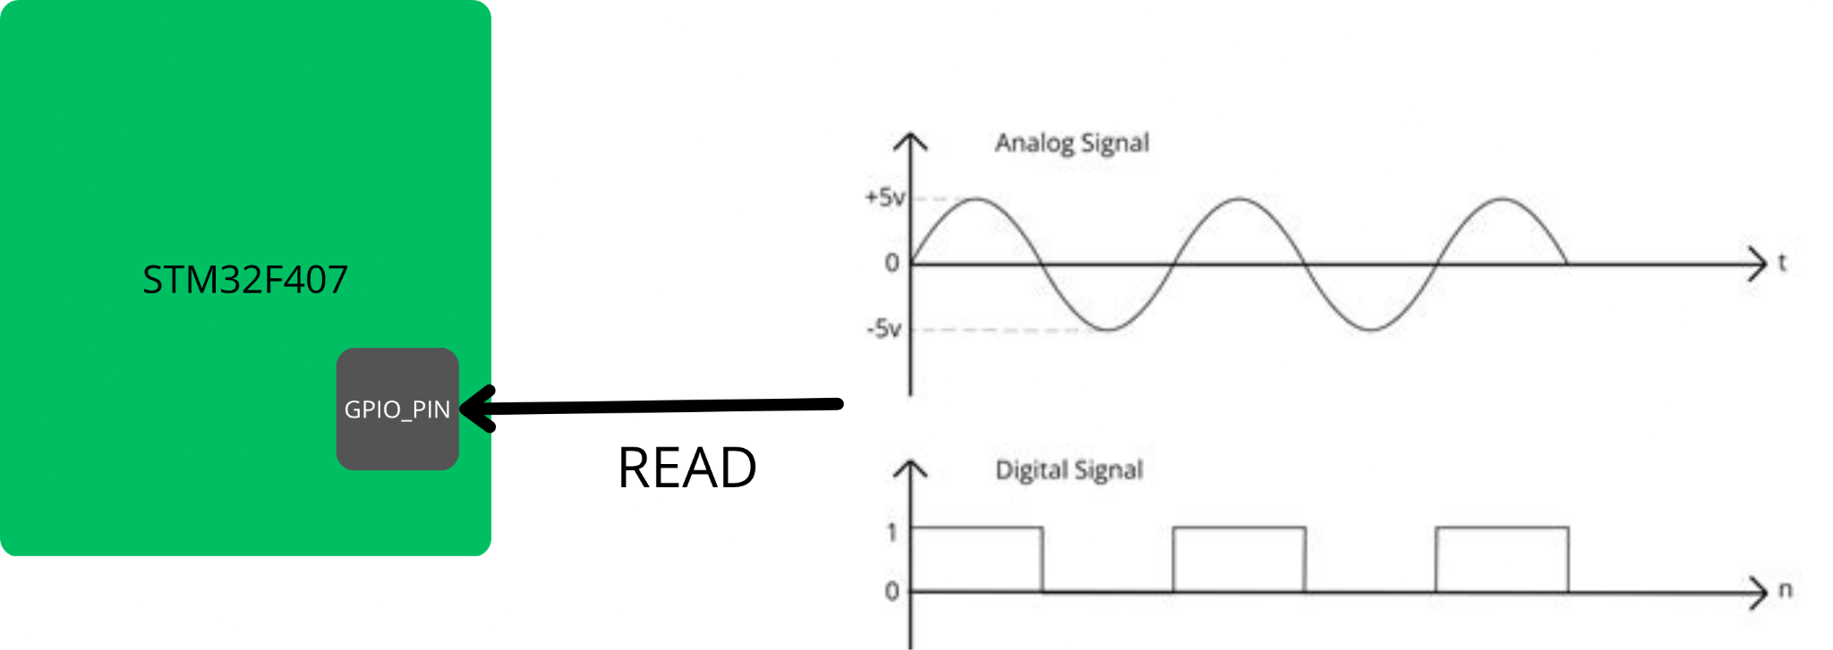
STM32 GPIO : General purpose Input Output
GPIO stands for General Purpose Input/Output. It’s the most basic and versatile feature of a microcontroller, the way it interacts with the outside world.
You can think of a GPIO pin as a configurable electrical pin on the chip that can either:
Send a signal to outside (as an output)
Read a signal coming from outside (as an input)

Slide 17
STM32 GPIO : GPIO Modes
The STM32 groups the GPIOS in to clusters called PORTs indicated by GPIOx .
By x we mean: GPIOA to GPIOI .
Each port has 16 pins: From 0 to 15
For example:
the internal Green LED PD12: GPIOD pin 12
The internal BTN PA0: GPIOA pin 0
The GPIO has 4 Modes:
Input
Output
Alternate function
analog

Slide 18
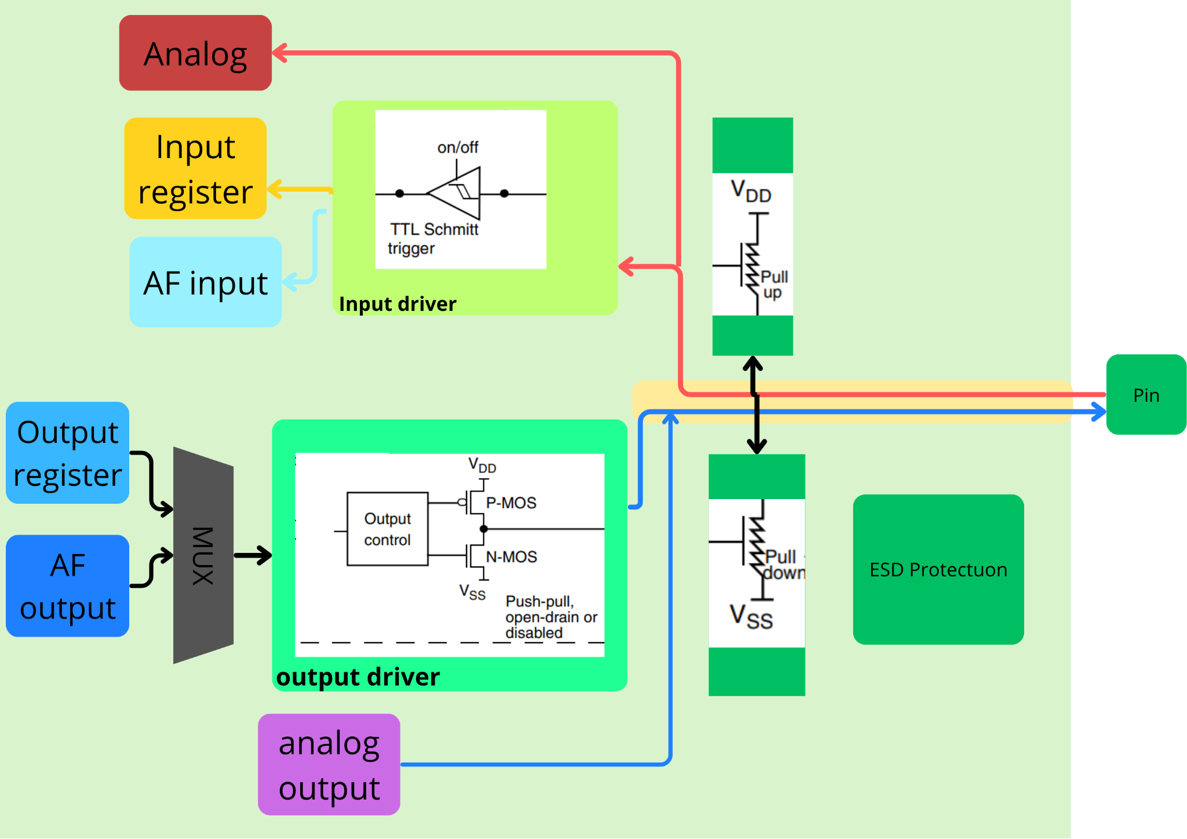
STM32 GPIO : GPIO Structure

Slide 19
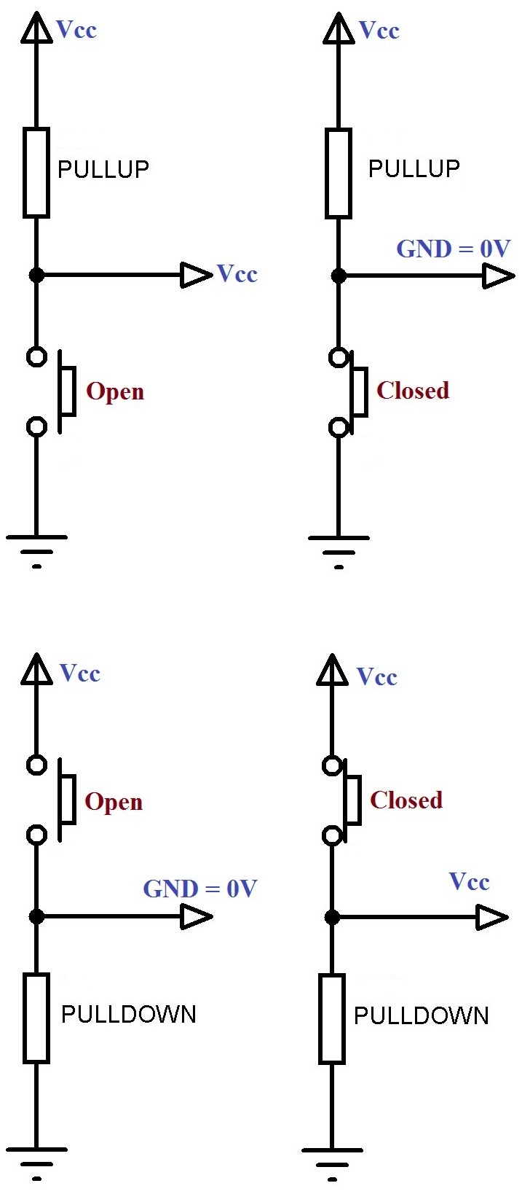
STM32 GPIO : GPIO Modes
Input Mode:
PullUP
NoPull: Floating input
PullDown: The input is set to logic low (0)
PullUp: The input is set to logic High (1)
PullDown

Slide 20
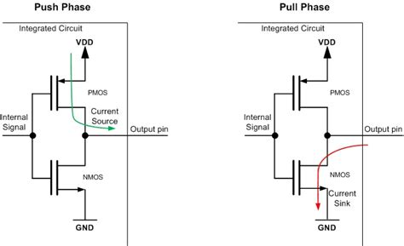
STM32 GPIO : GPIO Modes
Output Mode:
PushPull: Drives the pin to output a steady and stable voltage (3.3v).
Used for devices that doesn’t exceed the maximum output voltage that the stm32 can support
Example: Powering and LED, sensor
It contains 2 transistors: PMOS and NMOS, They both act as switches letting current in and out.
The PMOS is ON when he gets a LOGIC 0, hence he lets current pass form Vdd to the output pin (3.3V).
The NMOS is ON when he gets LOGIC 1, hence connecting the GND the the output pin (0V).
NOTE: Only one transistor works at a time, so when the PMOS is ON the NMOS is OFF and vice versa.

Slide 21
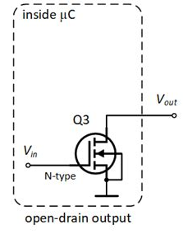
STM32 GPIO : GPIO Modes
Output Mode:
OpenDrain: Drives the pin Low (0V).
Used when there is a external energy Source (Vdd)
Example: Motor control, or controlling and LED or sensors that needs higher than (3.3V) to work.
Motor
NMOS
GND
Vdd
It contains 1 transistors: NMOS:
The NMOS is ON when he gets LOGIC 0, hence connecting the GND the the output pin (0V), the circuit closes and the motor spins.
LOGIC 1 closes the circuit and the NMOS is OFF.

Slide 22
Programming:
Toggling an LED connected in PD12
GPIOD
PIN12

Slide 23
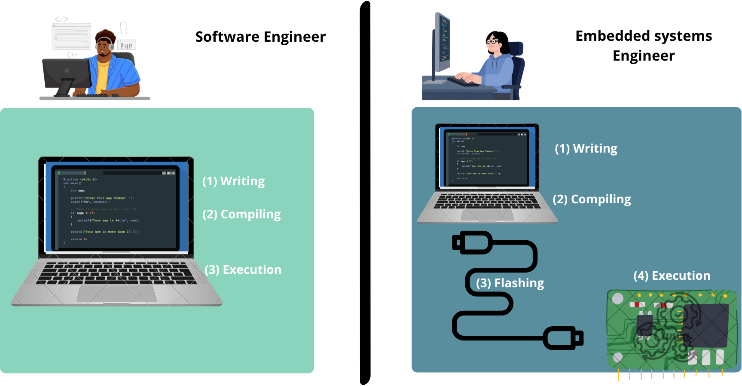
Programming:

Slide 24
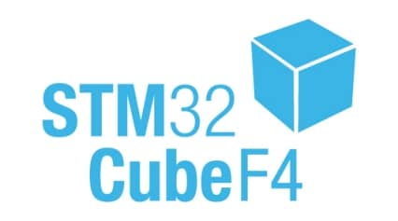
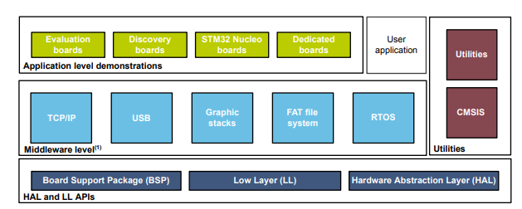
Writing the Software: HAL
STM32CubeF4 package: Github Link

Slide 25
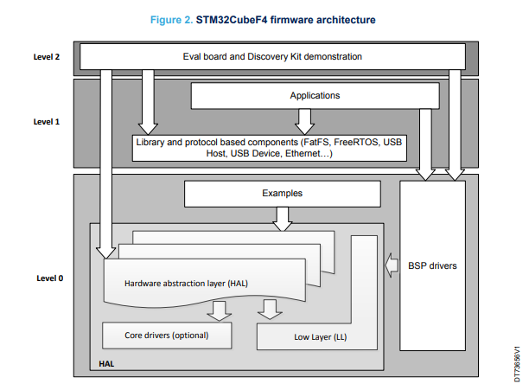
Writing the Software: HAL
Level 0: Hardware Interaction
This is the foundation that talks directly to the MCU and board components.
BSP (Board Support Package): Drivers for components on the board (LEDs, buttons, LCD screen). Example: BSP_LED_On().
HAL (Hardware Abstraction Layer): Easy & Portable. Generic APIs to use MCU peripherals (like UART, I2C) without deep register knowledge. Uses interrupts/DMA for you.
LL (Low-Layer): Lean & Fast. Lightweight, register-level drivers for experts who need maximum performance and minimal overhead.

Slide 26
Writing the Software: HAL
Level 1: Middleware & Services
This level provides advanced software features that sit on top of the HAL/LL.
Libraries & Stacks: Ready-to-use components like:
USB Host/Device libraries
Graphics Libraries (STemWin, TouchGFX)
Real-Time OS (FreeRTOS)
File System (FatFS)
TCP/IP Network Stack (LwIP)
SSL/TLS Security (mbedTLS)
Level 2: Final Application
This is the top level, where everything comes together.

Slide 27
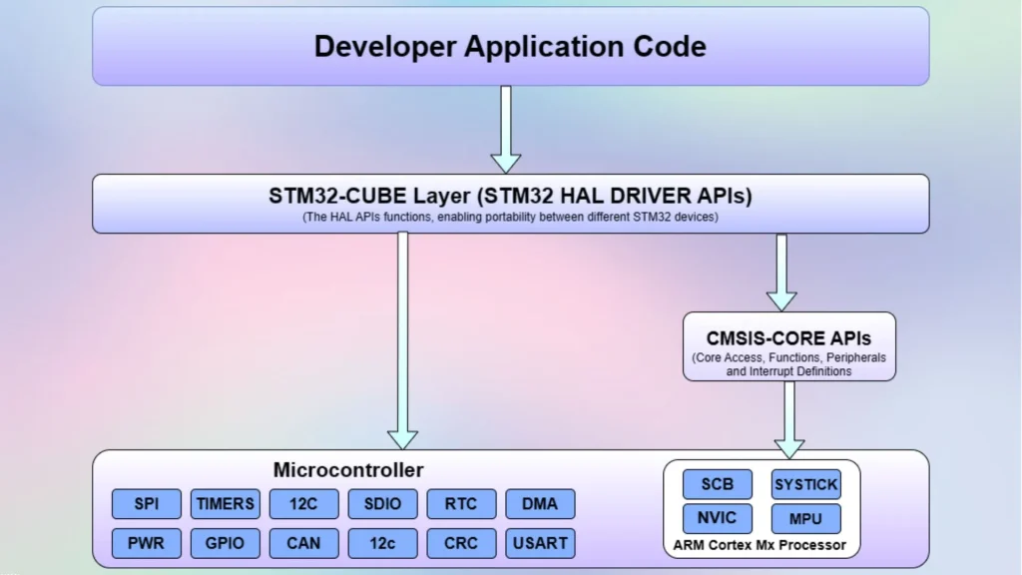
Writing the Software: HAL

Slide 28
Thank You

